Slide 1

RRT for Quadrotor Motion Planning with Danger Zones in The Environment
Roya Sabbagh Novin, Dejun Guo
Shantnu Kakkar, Xiang He
Supervisor: Dr. Herman
Fall 2015

Slide 2
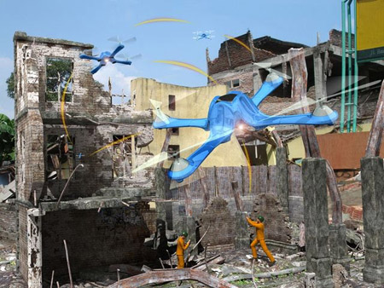
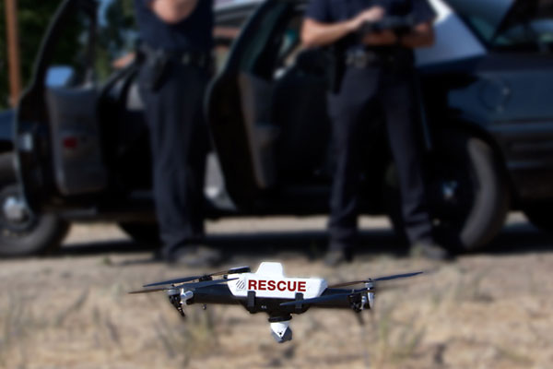
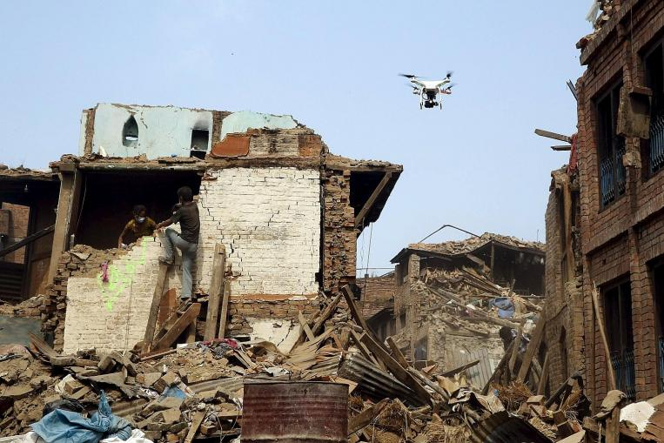
Introduction
Quadcopters rescue in damaged structures
Flexibility, e.g., hover and fly in complex areas

Slide 3
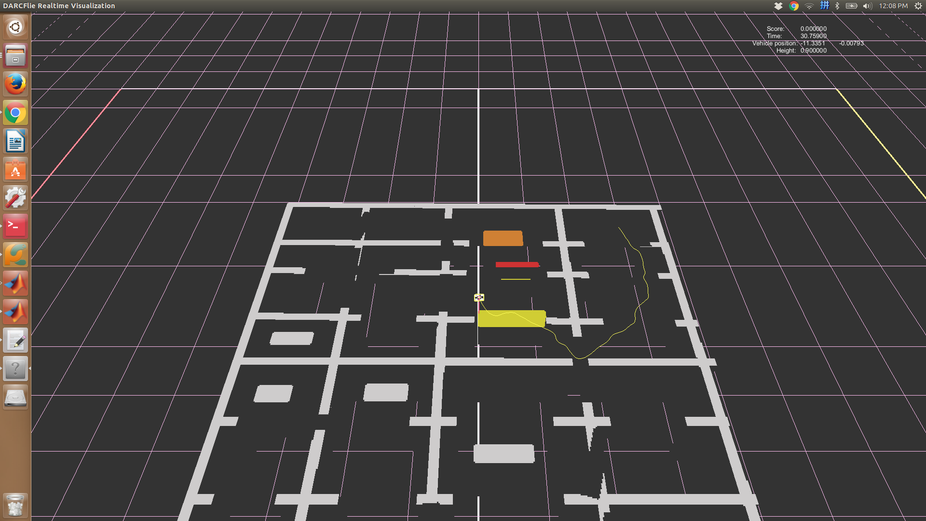
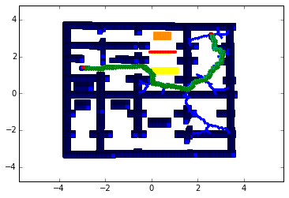
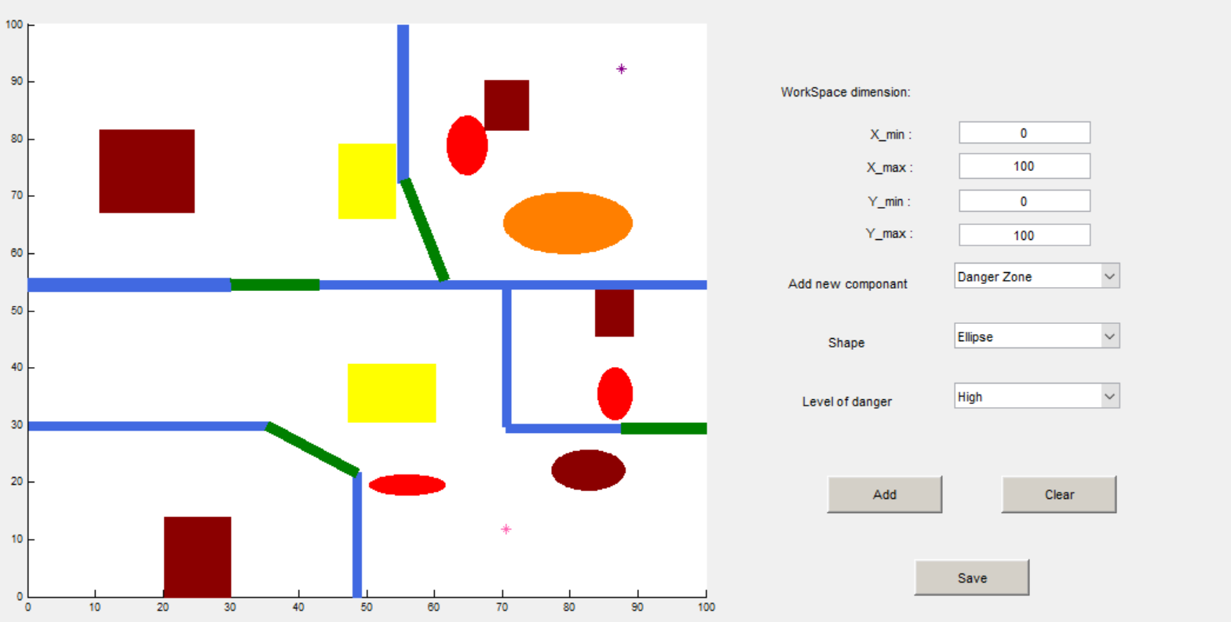
Project Definition
Map building: GUI + 3D environment
Path planning: RRT + cost + dynamic constraints
Path smoothing: Bspline

Slide 4

Why RRT?
Fast for single query requirement. Give little bias and it will boooom. (PRM requires some additional steps)
Kinematic and dynamic constraints. (acceleration, velocity, etc.)
Collision checking is a separate independent module.

Slide 5
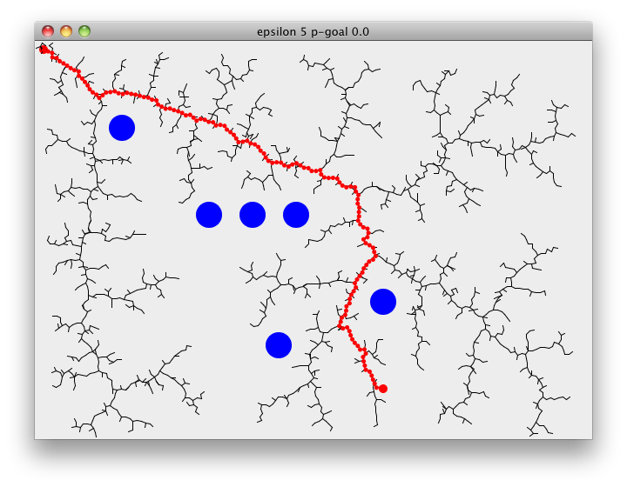
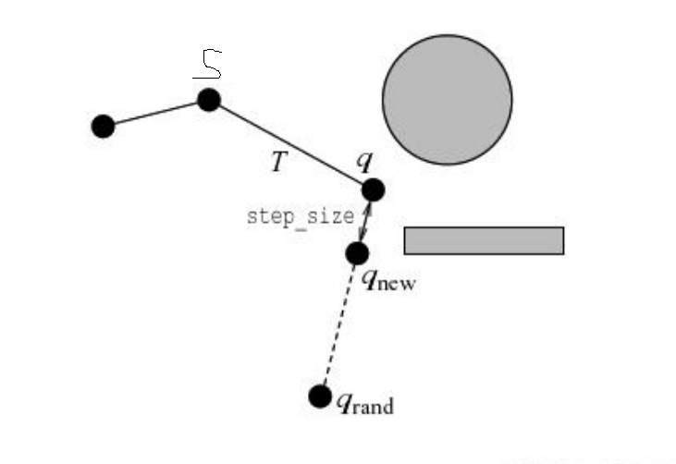
Basic RRT
Drawbacks:
Danger zones
Constraints
Smoothness
*Choset, Howie; “Principles of Robot motion”

Slide 6
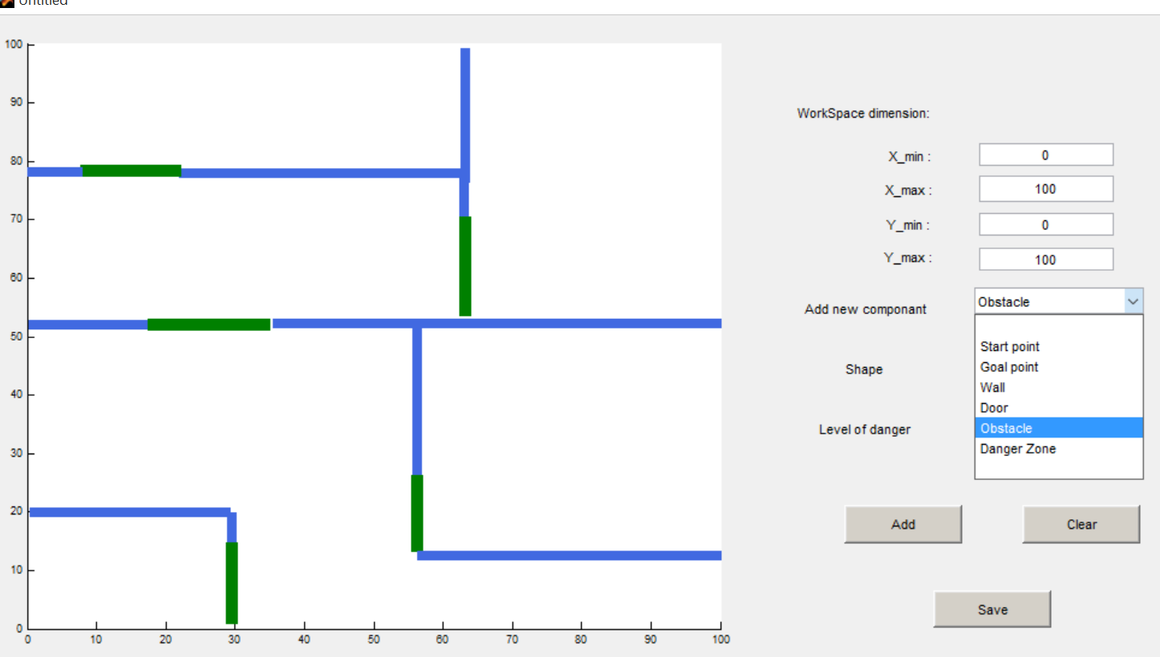
Graphical user interface (GUI)
Different elements
Different shapes
Level of danger

Slide 7



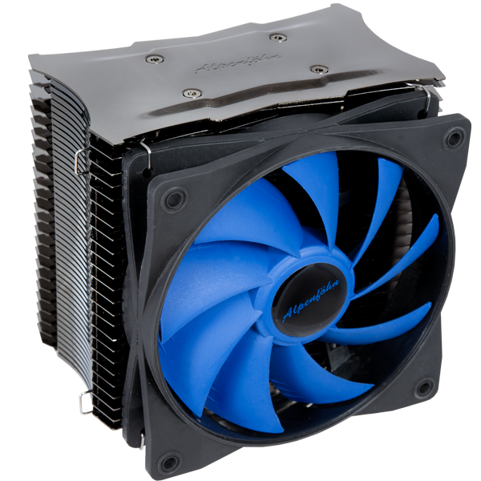
Danger Zones
A danger zone is an area with hazardous condition, i.e., heating, poor wireless networking, air flow, …
The path is allowed to intersect with the danger zones but this should be avoided as much as possible considering the level of danger.
The level of danger determines how much the area should be avoided.

Slide 8
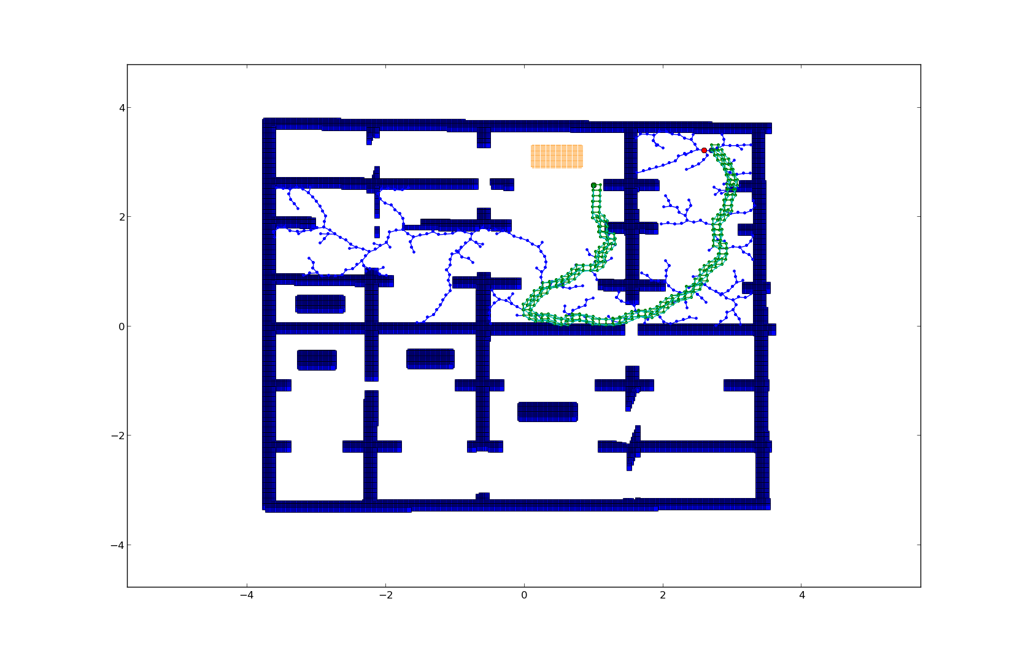
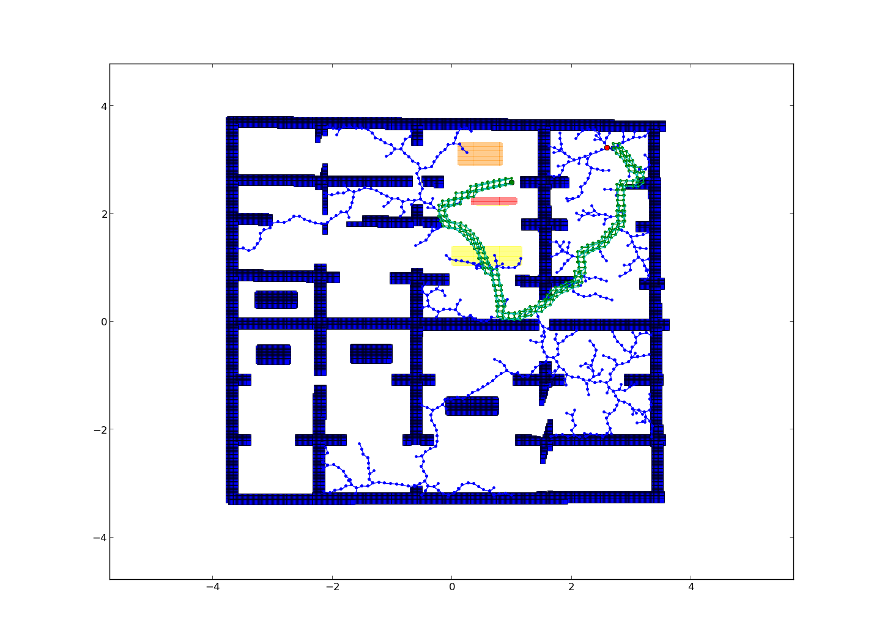
Cost function
No danger: d = norm(new_sample – n_i)
Low danger: 1.3*d
Medium danger: 1.4*d
High danger: 1.5*d

Slide 9
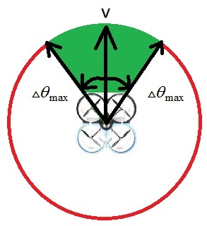
RRT Constrained
Constraints:
Limit on acceleration
Limit on turning angle

Slide 10
Path smoothing
It is a post processing tool to ensure that there are no abrupt changes in direction. (in other words, it ensures continuity of velocity, acceleration and radius of curvature)
RRT Constraint helps satisfy acceleration limits, but continuity is not ensured.
Method used: B-splines

Slide 11
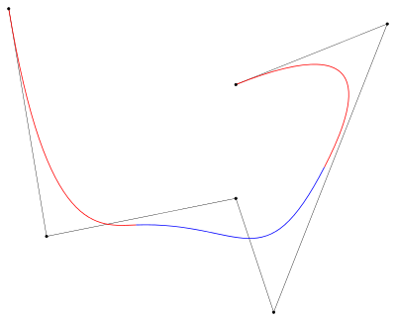
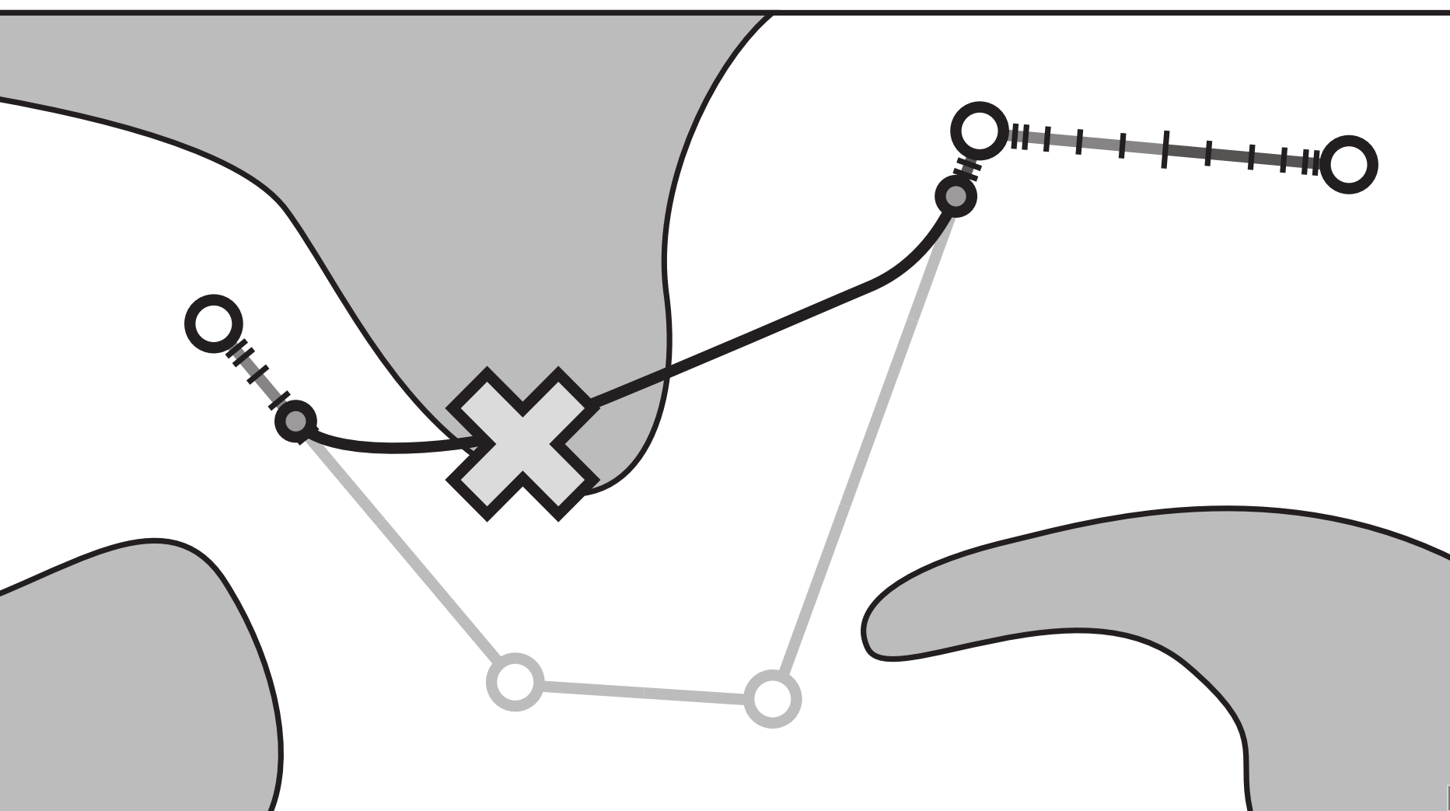
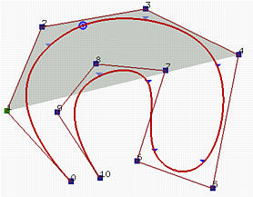
PATH SMOOTHING
Bsplines:
local support. Re-positioning of path points & introducing pseudorandom points
continuous (can go up to C3 continuity without increasing program complexity)
No wobbling, curve within convex hull

Slide 12
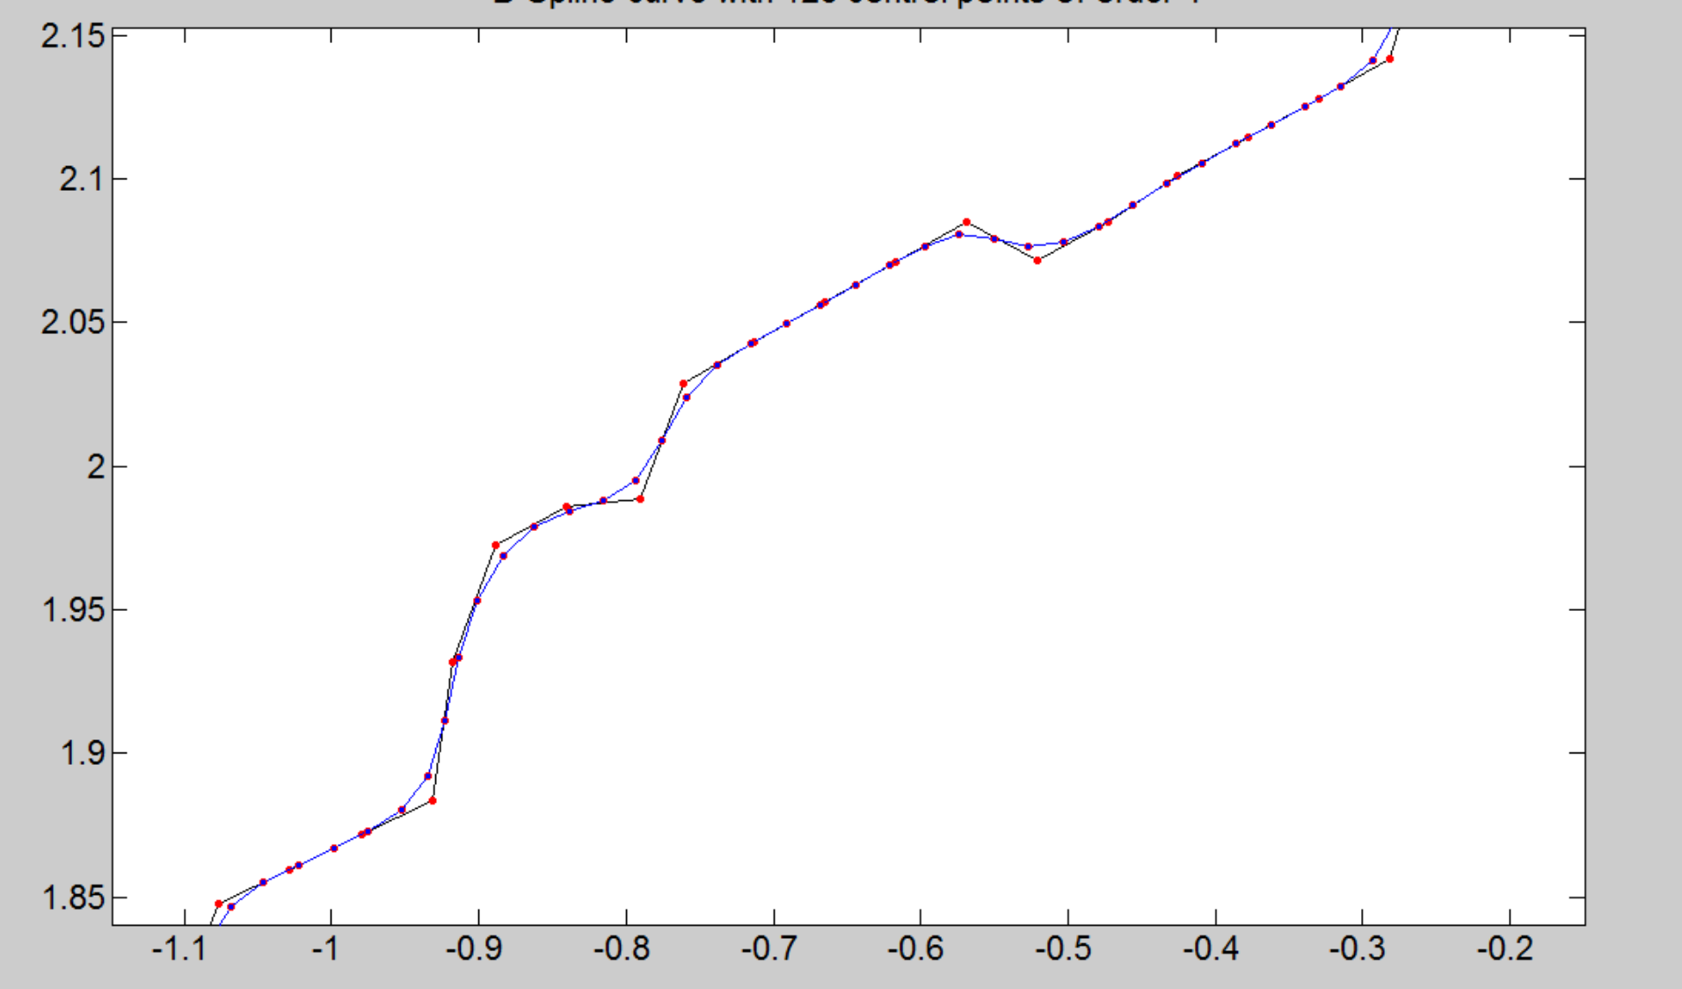
Path smoothing

Slide 13
Developing map
Read image produced by the GUI
Use the RGB components produced in the image to know free space, obstacles, start, goal, etc.
Generate a txt file based on the RGB values.

Slide 14
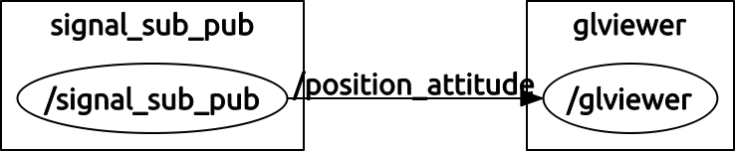
3D environment
Used Open GL for 3d visualization
Used ROS for communicating. Two nodes are made, one of which reads the file containing the path. This node then passes position and attitude data to the other node (the open GL node).
OPEN GL
Position
Reading node
Attitude

Slide 15
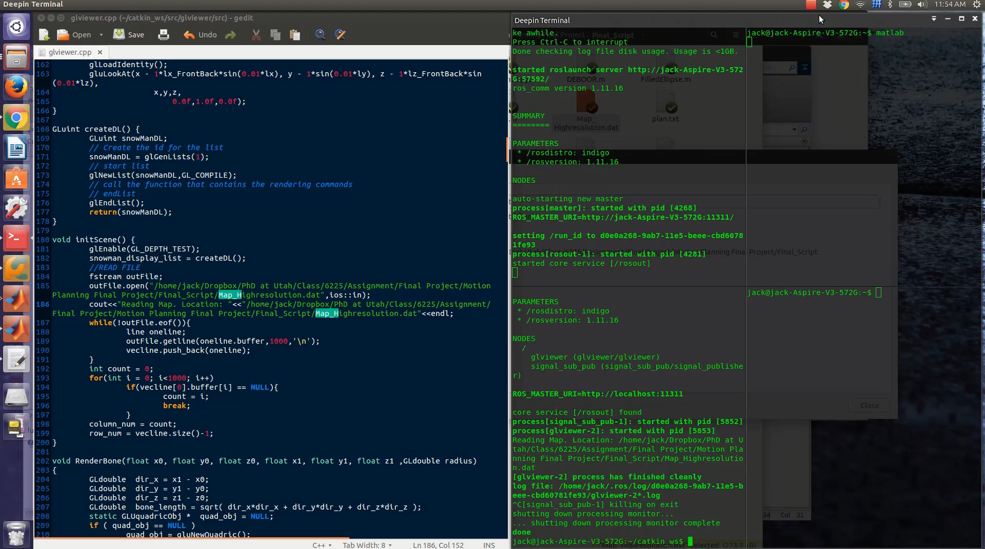
Final Result

Slide 16
Conclusion
Method:
Developed a GUI for user-friendly inputs
Basic RRT + Cost function + Acceleration constraints
Smoothing using B-splines
Developed a 3D environment for better visualization
Results and future work:
Find and smooth path considering the constraints and danger zones
Considering narrow passages
More realistic danger zones
More complicated dynamic constraints

Slide 17
References
D. Sent, M. H. Overmars. "Motion planning in environments with danger zones." IEEE International Conference on Robotics and Automation, ICRA. Vol. 2, 2001.
Choset, Howie M. Principles of robot motion: theory, algorithms, and implementation. MIT press, 2005.
Koyuncu, Emre, and Gokhan Inalhan. "A probabilistic b-spline motion planning algorithm for unmanned helicopters flying in dense 3d environments." Intelligent Robots and Systems, 2008. IROS 2008. IEEE/RSJ International Conference on. IEEE, 2008.

Slide 18

Thanks For Your Attention! ☺

Slide 19
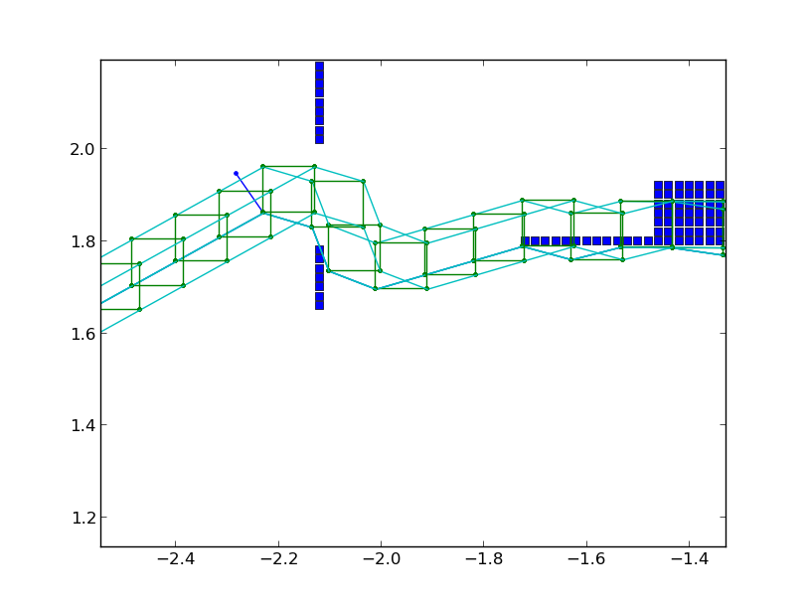
Collision checking

